Slide 2
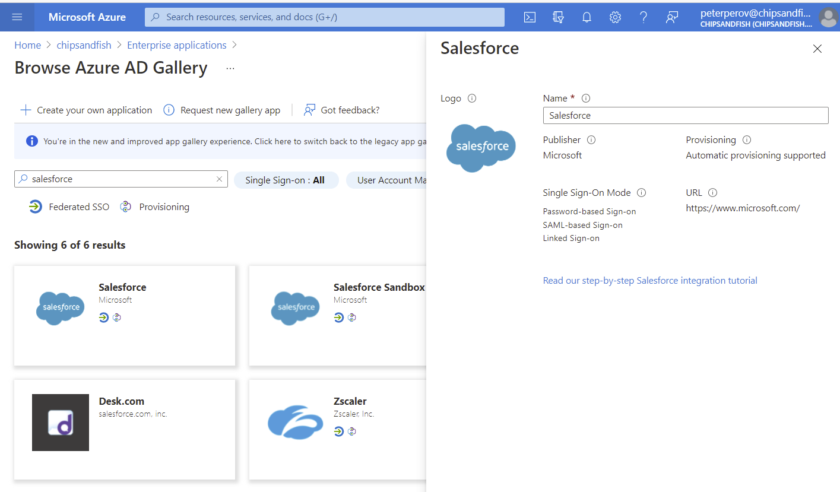
Add Salesforce App from the gallery

Slide 3
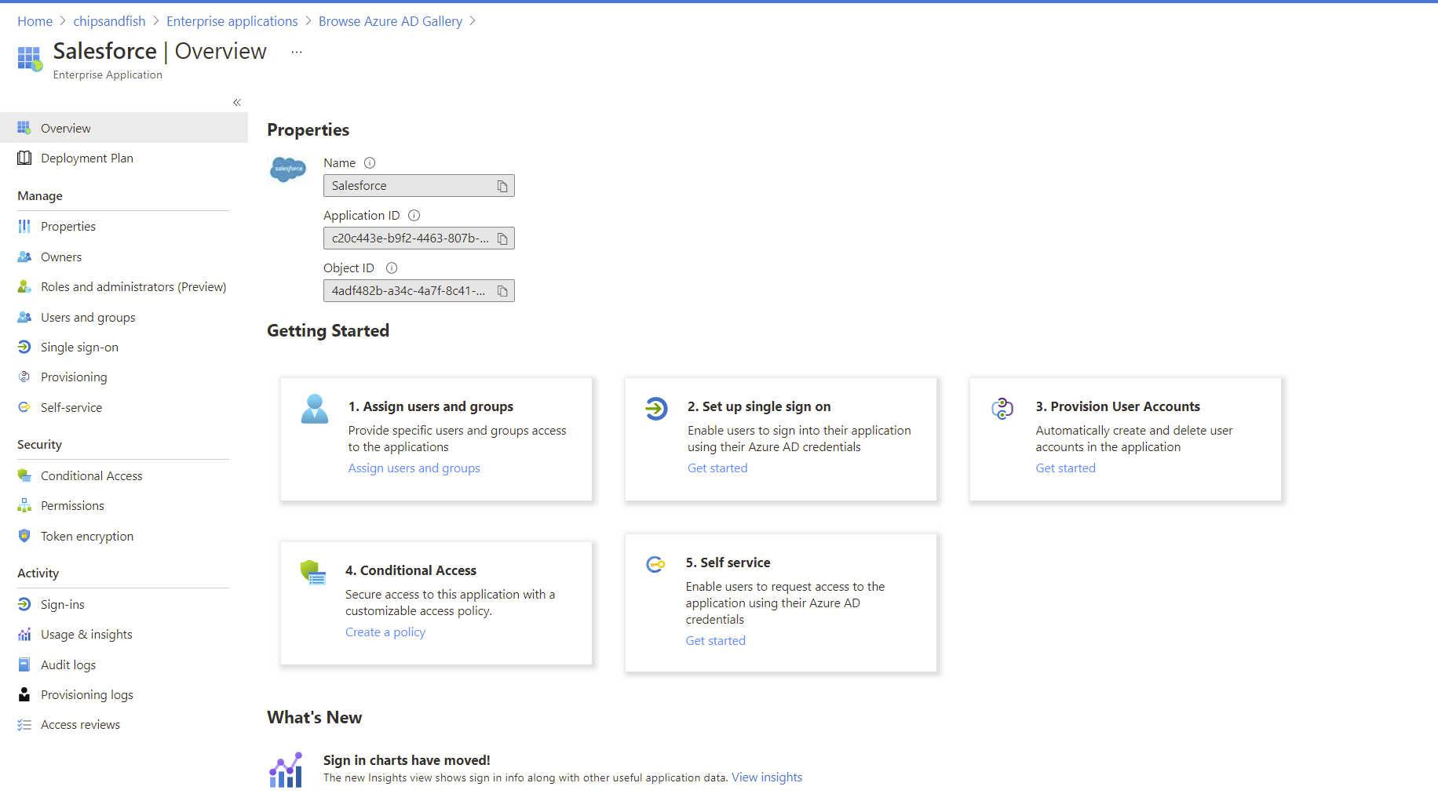

Slide 4
